Slide 1

Maximizing Stock Portfolio Growth in US Market
Pinyo Kewdumrongtum Rebecca Tang
Ethan Sung
(312712017) (312712013)
(313712003)

Slide 2
Agenda
Project Motivation
Overview Study Plan
3. EDA Outcome and Analysis
4. Model Selection and Predictive Result
5. Portfolio KPI Measurement
IDA Template

Slide 3
Overview Study Plan
Stock Selection
Data Collection
Exploratory Data Analysis (EDA)
Selected Stocks:
- Exxon Mobile (XOM)
- Pfizer (PFE)
- Microsoft (MSFT)
Using Python programming to export past recorded stock price from “yahoofinance”
(ref: https://finance.yahoo.com/markets/)
Outcome Diagram:
General stock price plot vs time
Box Plot
Normal distribution plot of return
Time series return
Sharp Ratio
Portfolio KPI Measurement
Model Selection for training & testing
Benchmark with ‘Equal-weigth Average Portfolio’ in the term of:
Annual Return
Sharp Ratio
Max. Drawdown
Volatility
Selected Models:
ARIMA
Random Forrest
XGBOOST
Using ‘K-Fold Cross Validation’ concept to train and test
IDA Template

Slide 4
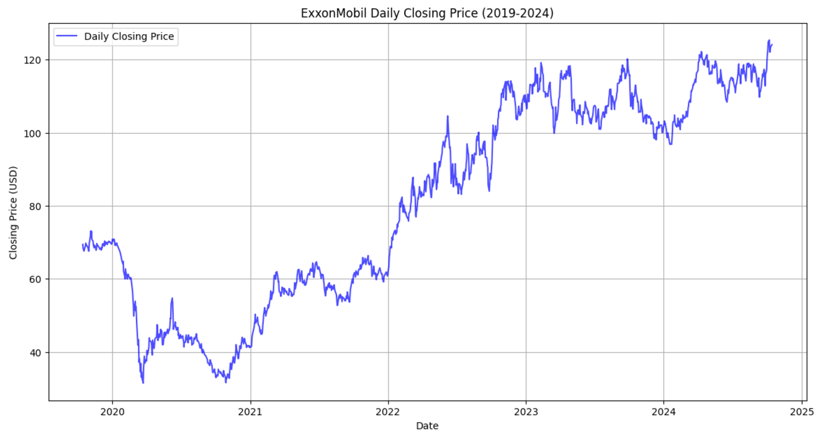
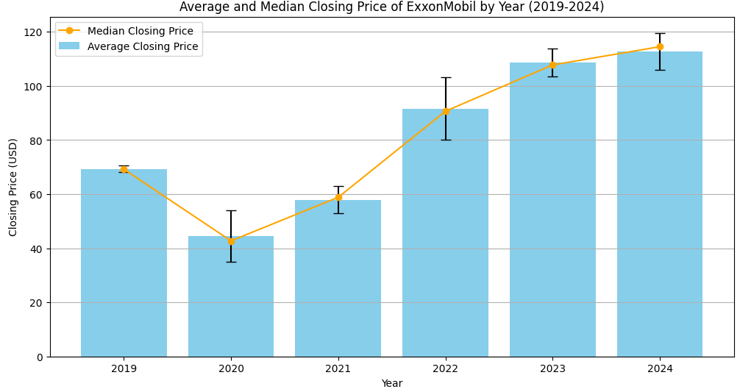
EDA Outcome and Analysis
1. Exxon Mobile
XOM stock price shows:
1. Continuous upward trend since 2020
2. Show the long term and sustainable growth
3. Growth rate is less after 2023
The diagram shows that:
Average closing price and median price by year is almost equal
Variance of closing price in 2020 and 2022 are higher than other years
IDA Template

Slide 5
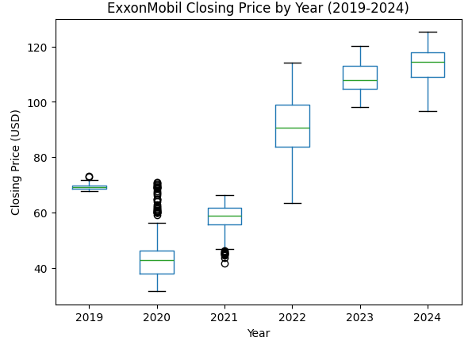
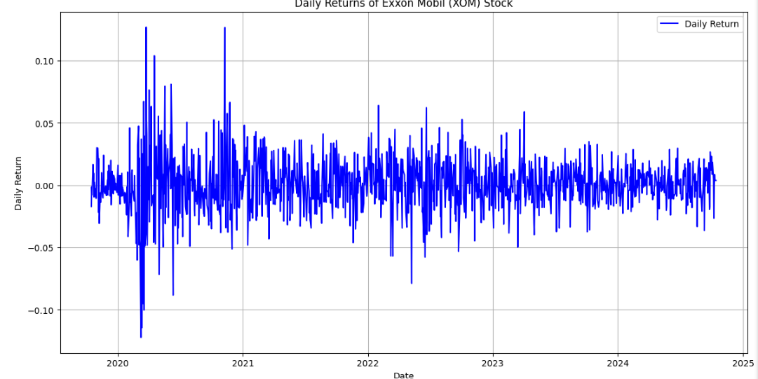
EDA Outcome and Analysis
1. Exxon Mobile
Box plot diagram shows that:
2020 has many outliers than other years meaning that the price variation is extremely fluctuated
Daily return diagram shows that:
The variation of daily return is high during 2020 to 2021, and it is gradually reduced after 2021
IDA Template

Slide 6
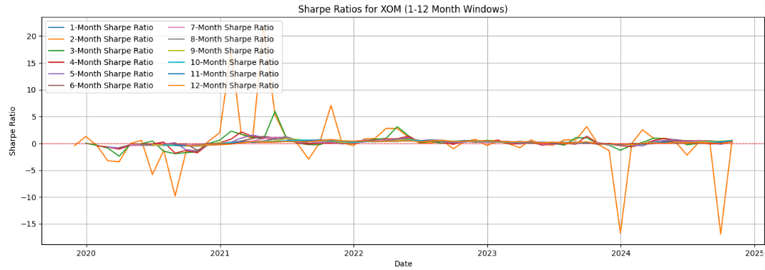
EDA Outcome and Analysis
1. Exxon Mobile
Sharp Ratio shows that:
2- and 3- months sharp ratio period provide the highest return from XOM stock
Period Selection of Dynamic Strategy:
3 months might be a good period for a dynamic strategy since it provide above average return with less risk compared to 2 months
IDA Template

Slide 7
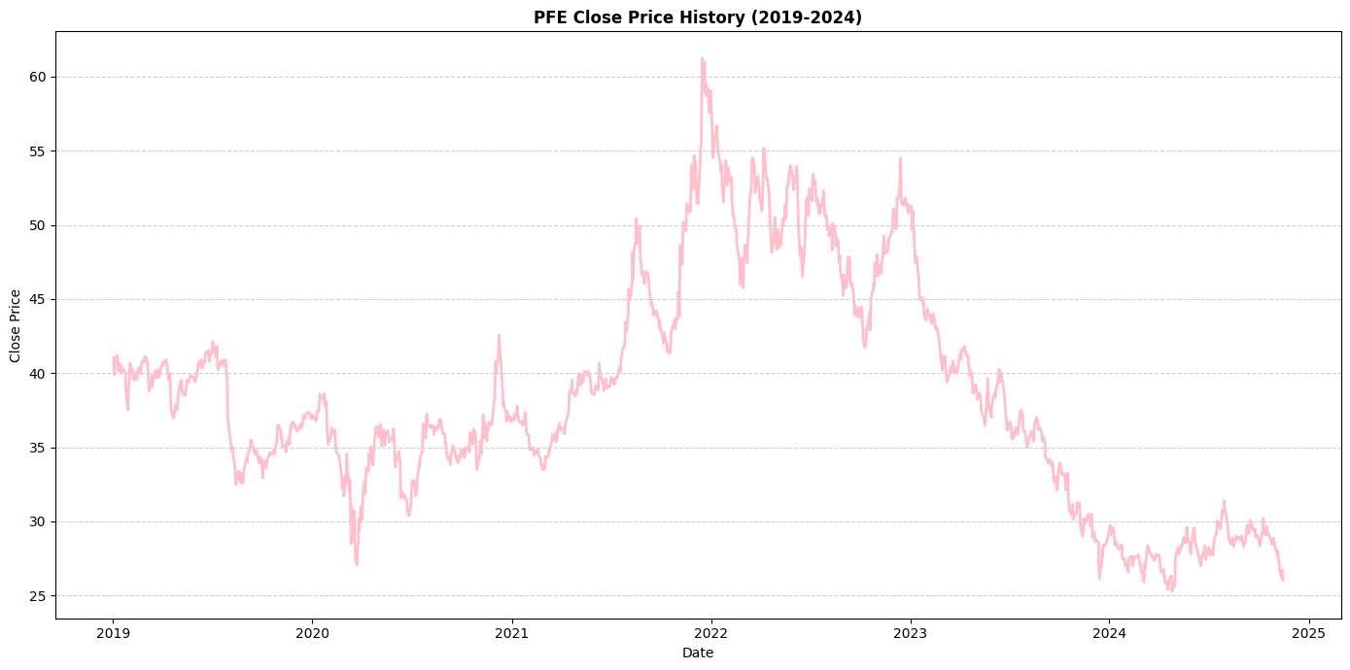
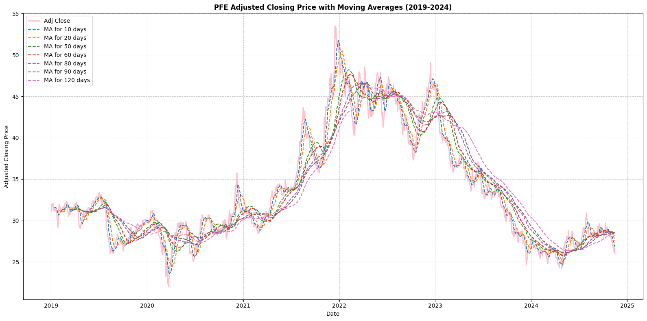
EDA Outcome and Analysis
2. Pfizer
PFE stock price shows:
2022 Peak: Due to pandemic (over $60)
2. 2023-2024 Decline: Steadily declined from the 2022 peak to around $30.
3. Support Zone: The current price is close to the support range in 2019-2020 ($30-$40).
The average shows that:
1. Since the peak in 2022, all MA have gradually declined, indicating a long-term downtrend. Additionally, short-term MAs are mostly below long-term MAs, further confirming market weakness
IDA Template

Slide 8
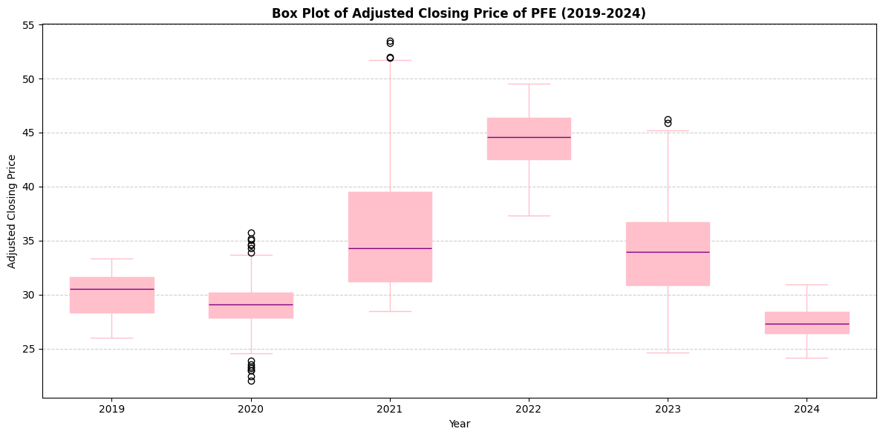
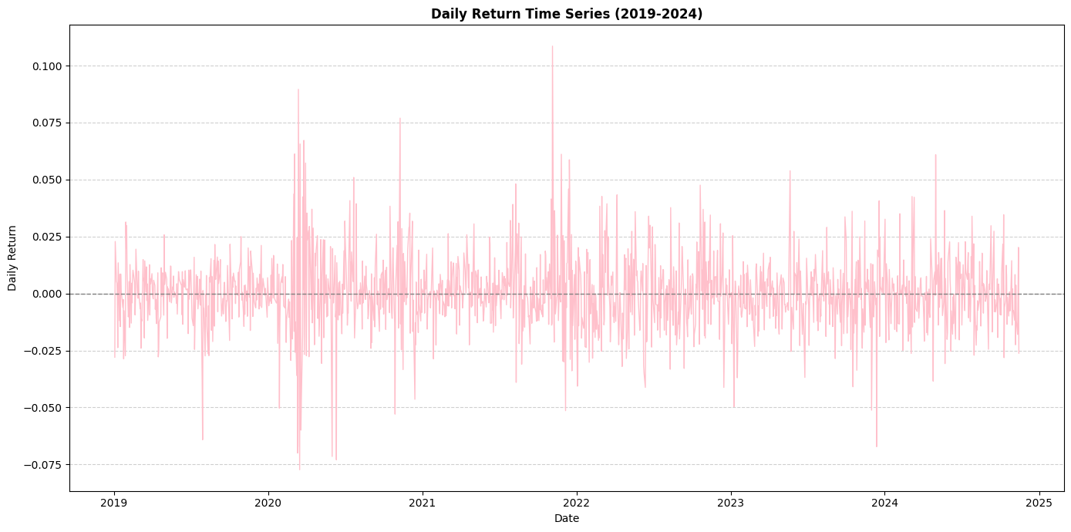
EDA Outcome and Analysis
2. Pfizer
Box plot diagram shows that:
1.2020: Low outliers below due to pandemic-induced panic selling.
2.2021: High outliers possibly related to revenue surge from vaccine business.
3.2023: High outliers likely driven by short-term rebounds or market optimism.
Daily return diagram shows that:
2020-2021 has many outliers than other years meaning that the price variation is extremely fluctuated
IDA Template

Slide 9
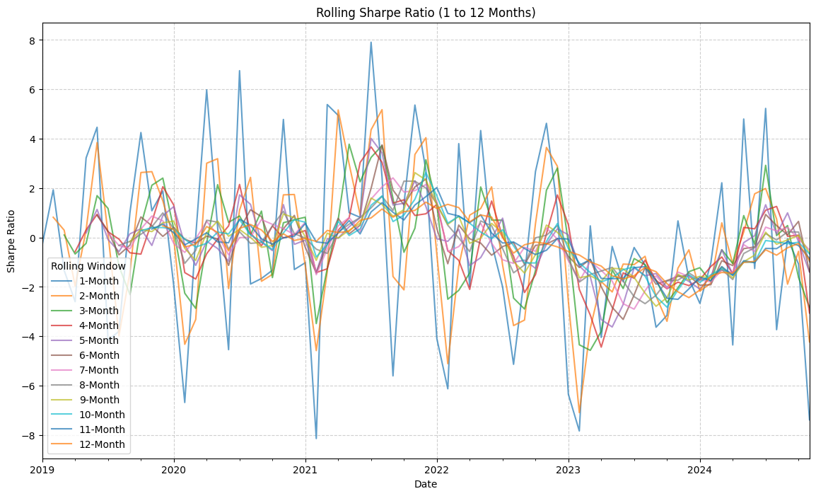
EDA Outcome and Analysis
2. Pfizer
Period | Average Sharpe | Analysis
1-3 Months | 5.62 | Highest Sharpe Ratio, suitable for short-term investment.
4-6 Months | 3.81 | Stable returns, good for mid-term investment.
7-9 Months | 2.44 | Sharpe Ratio starts declining, long-term returns weaken.
10-12 Months | 2.03 | Lowest Sharpe Ratio, long-term holding not recommended.
Period Selection of Dynamic Strategy:
Short-term investments (1-3 months) have the highest average Sharpe Ratio (5.62), indicating the best risk-adjusted returns and suitability for quick profit strategies.
IDA Template

Slide 10
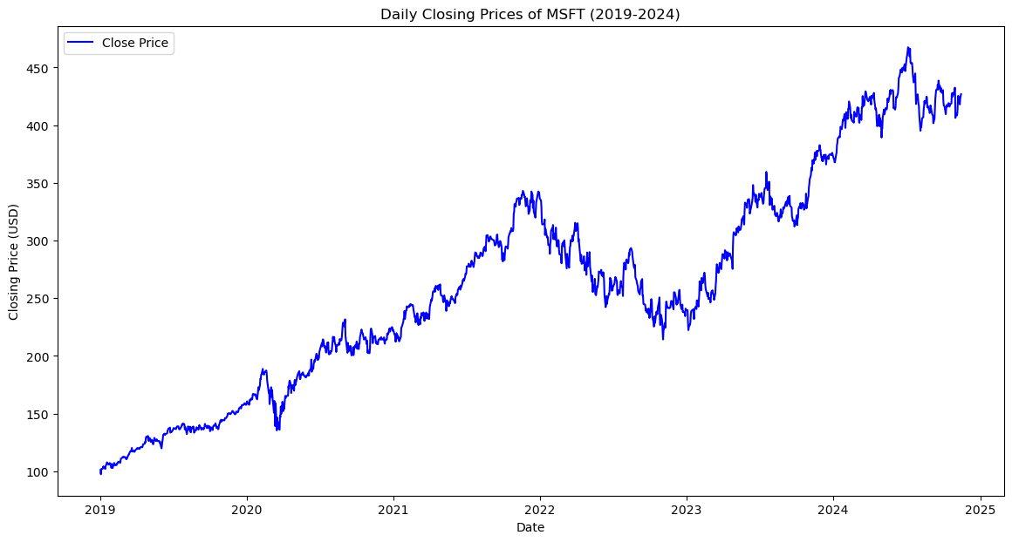
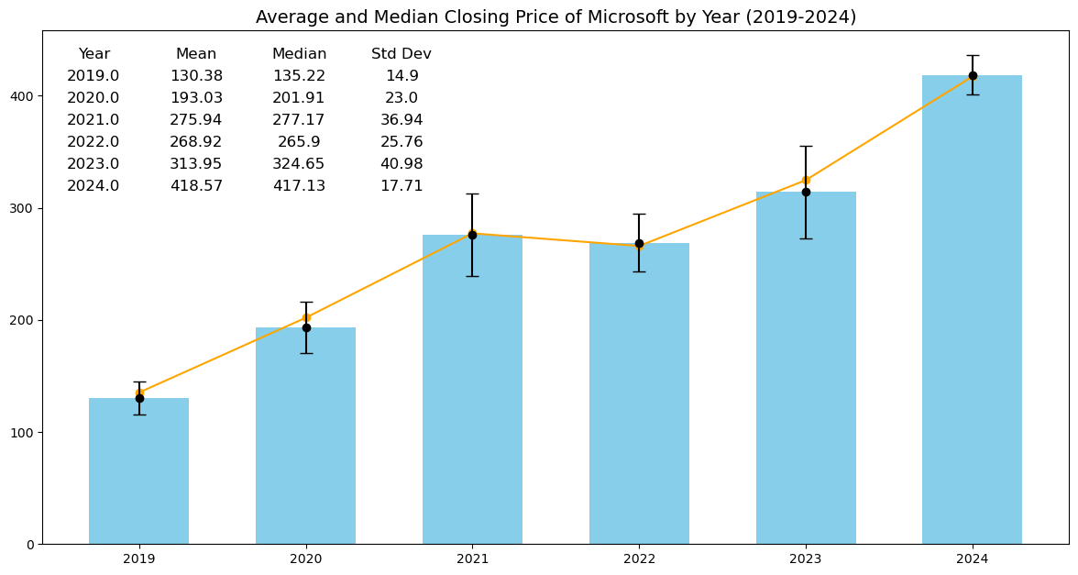
EDA Outcome and Analysis
3. Microsoft Corp (MSFT)
MSFT stock price shows:
2020 recovery from cloud demand
2022 correction due to rates
Stable growth post-2023, >$400
The diagram shows that:
1. Average and Median Closing Price: The yearly average and median closing prices are nearly identical
2. Variance: Closing prices in 2021 and 2023 show higher variance compared to other years
IDA Template

Slide 11
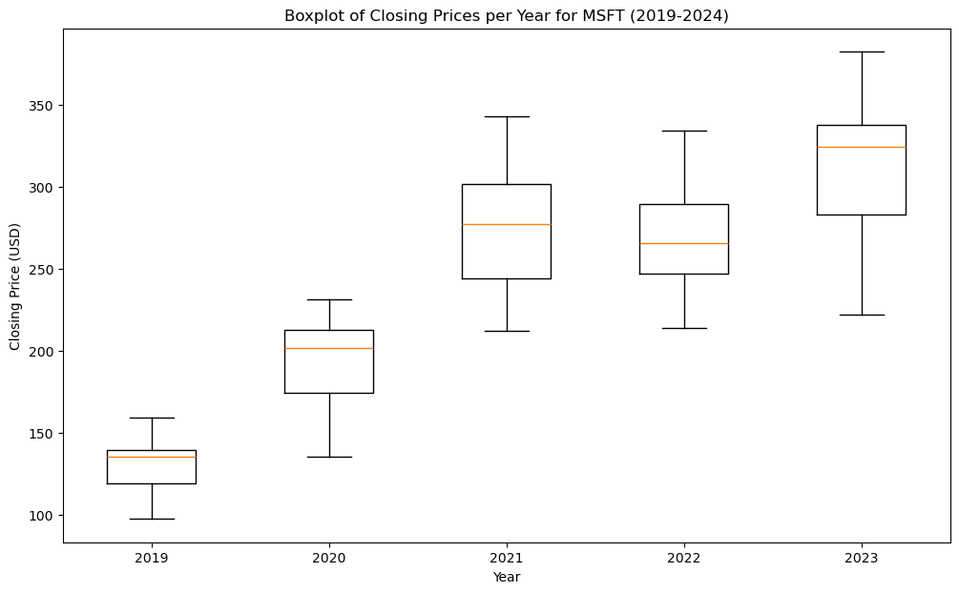
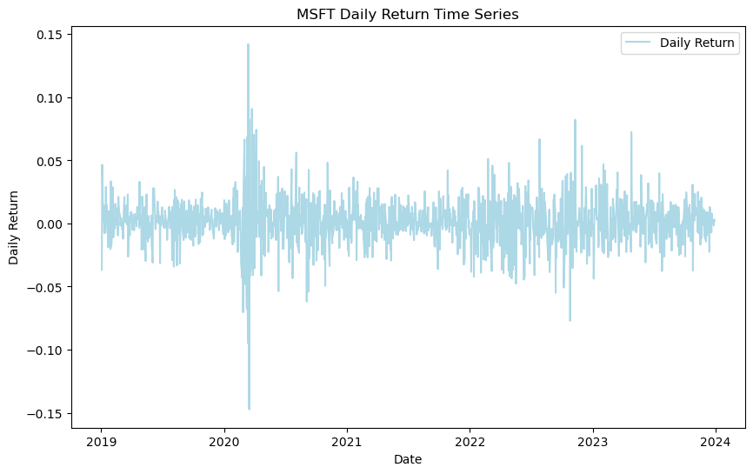
EDA Outcome and Analysis
3. Microsoft Corp (MSFT)
Box plot diagram shows that:
From 2019 to 2024,median closing price showed consistent growth. However, the widening interquartile range indicates increasing volatility
Daily return diagram shows that:
In 2020, significant volatility highlights market instability, while post-2021 shows decreased fluctuations, indicating more stable performance
IDA Template

Slide 12
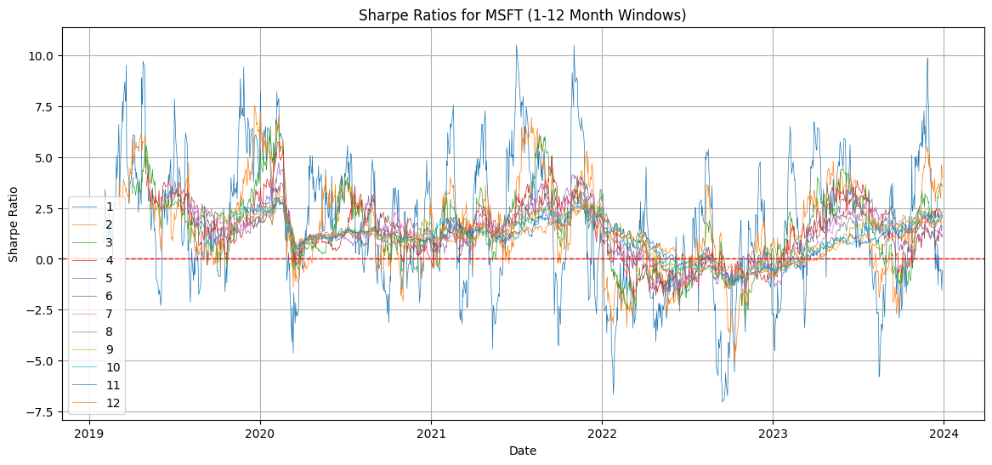
EDA Outcome and Analysis
3. Microsoft Corp (MSFT)
Sharp Ratio shows that:
Short-term investments (1-3 months) show the highest average Sharpe Ratio, making them ideal for quick profit strategies
Period Selection of Dynamic Strategy:
Longer-term periods (6-12 months) offer more stable but moderate returns, suitable for conservative investors
IDA Template

Slide 13
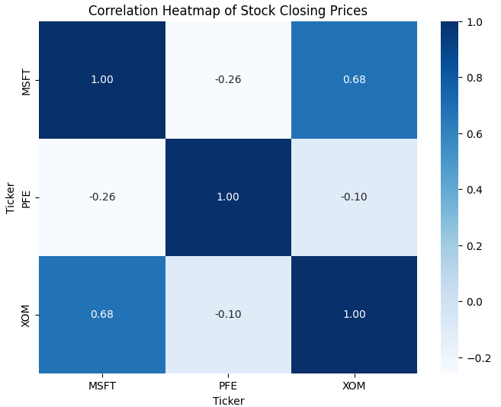
EDA Outcome and Analysis
Stock Correlation Heat Map
Correlation heat map shows that:
The correlation between a pair of stocks is not closely related
IDA Template

Slide 14
Model Selection and Predictive Result
IDA Template

Slide 15





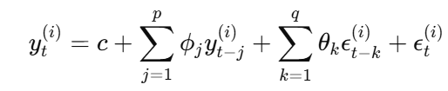
Auto Regressive Integrated Moving Average (ARIMA)
Objective Eq.:
Predictive Eq.:
AR:
I:
MA:
IDA Template

Slide 16
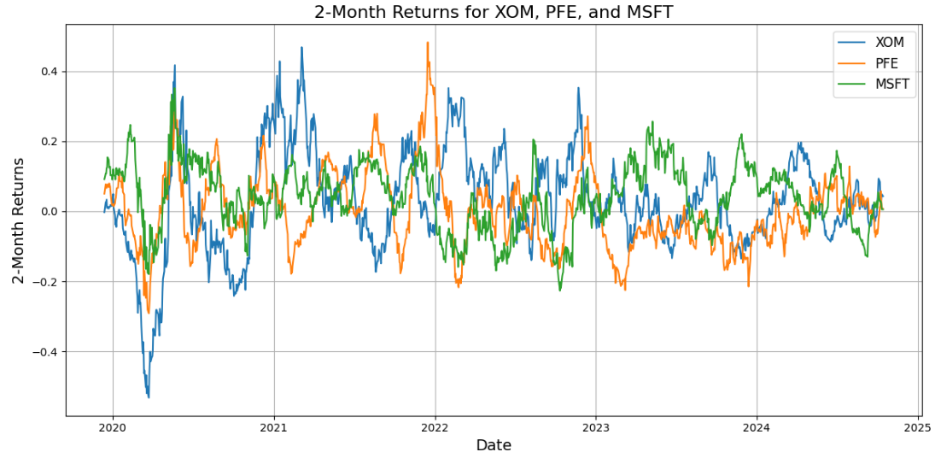
Auto Regressive Integrated Moving Average (ARIMA)
Step 1 : Calculate return from the stocks every 2 months
Step 2 : Separate training and testing dataset (70% training, 30% testing)
IDA Template

Slide 17
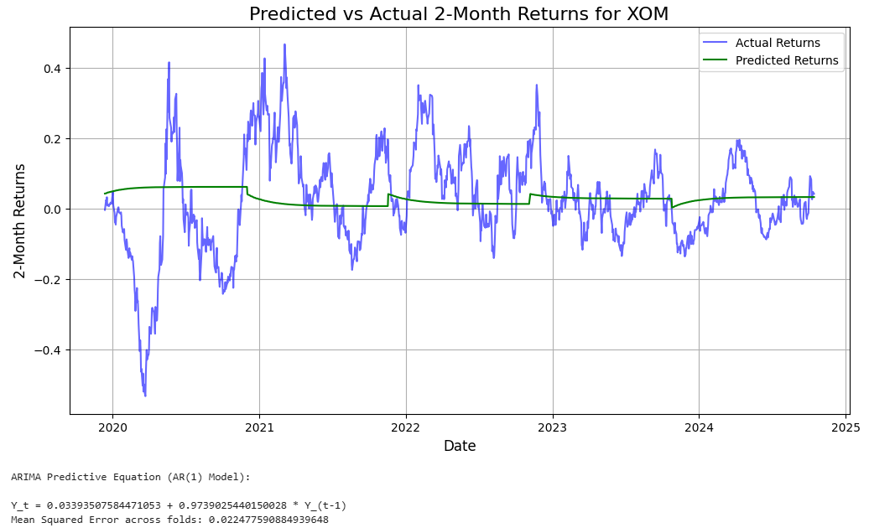
Auto Regressive Integrated Moving Average (ARIMA)
Step 3 : Run ARIMA model to find the predictive equation and test the model by using K-Fold Cross Validation approach
IDA Template

Slide 18
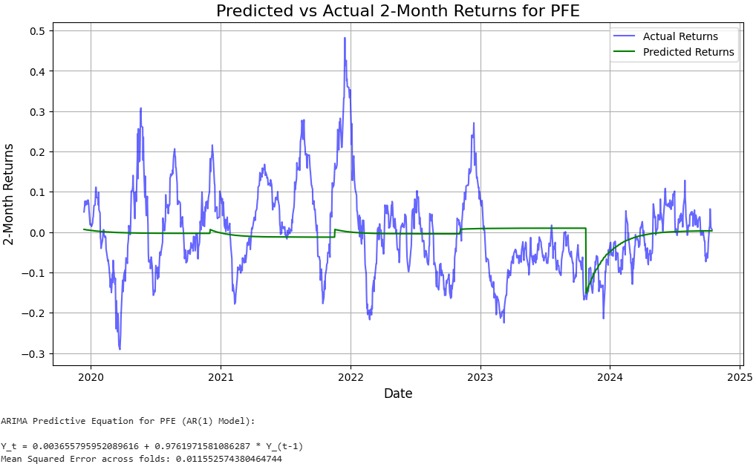
Auto Regressive Integrated Moving Average (ARIMA)
Step 3 : Run ARIMA model to find the predictive equation and test the model by using K-Fold Cross Validation approach
IDA Template

Slide 19
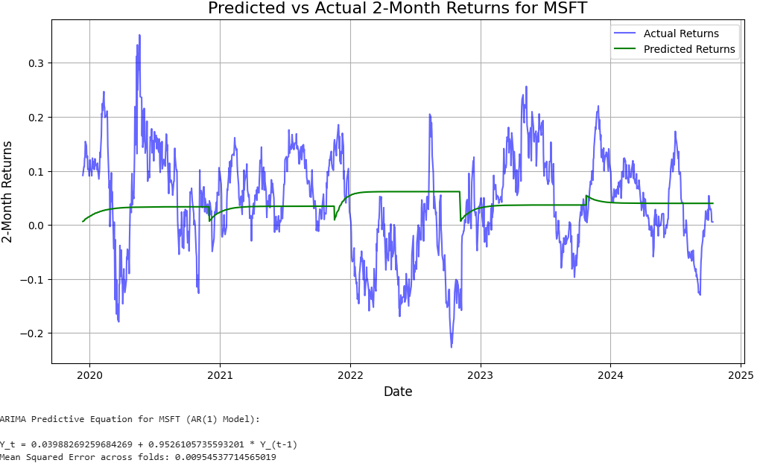
Auto Regressive Integrated Moving Average (ARIMA)
Step 3 : Run ARIMA model to find the predictive equation and test the model by using K-Fold Cross Validation approach
IDA Template

Slide 20

Auto Regressive Integrated Moving Average (ARIMA)
Step 4 : Combine predictive equation of returns from XOM, PFE, and MSFT
While,
IDA Template

Slide 21
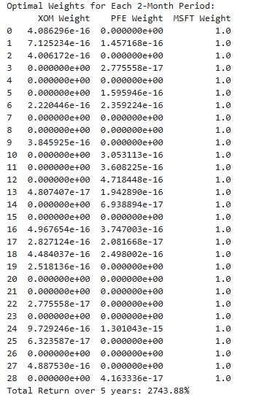
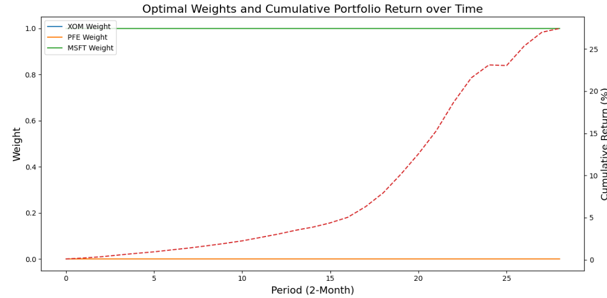
Auto Regressive Integrated Moving Average (ARIMA)
Step 5 : Implementing a dynamic strategical weighting with the predictive equation
IDA Template

Slide 22

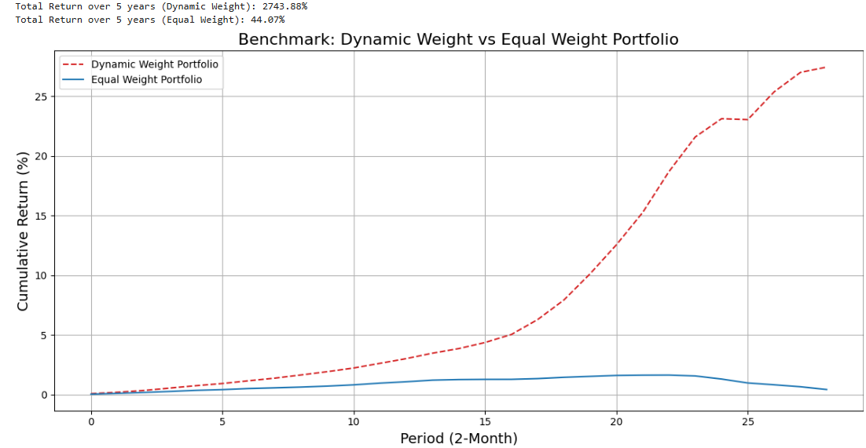
Auto Regressive Integrated Moving Average (ARIMA)
Step 6 : Benchmarking the return from ARIMA model with dynamic-weight strategy and Equal-weight Average Model
Conclusion
The annual return of dynamic-weight strategy with ARIMA predictive equation provide return 12.6 times more than equal-weight average
IDA Template

Slide 23
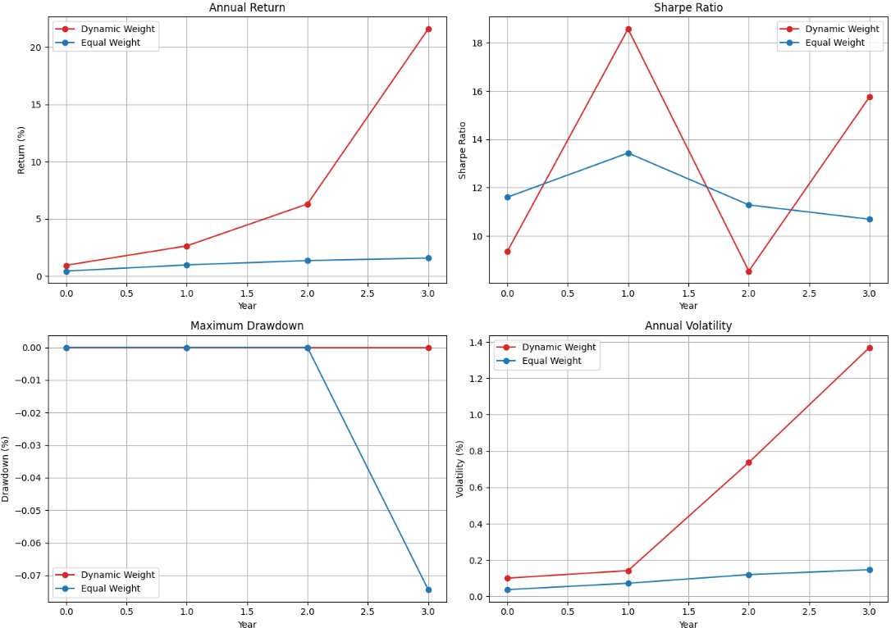
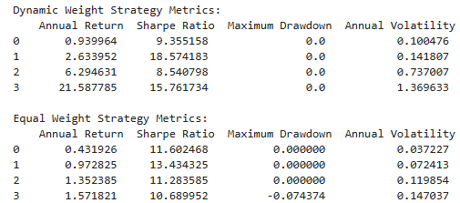
Auto Regressive Integrated Moving Average (ARIMA)
Step 6 : Benchmarking the return from ARIMA model with dynamic-weight strategy and Equal-weight Average Model
Key KPI Measurement:
1.) Annual Return
2.) Annual Sharp Ratio
3.) Max. Drawdown
4.) Annual Volatility
Conclusion
Annual Return: Dynamic strategy is higher
Sharp Ratio: Dynamic strategy is averagely higher
Max. Drawdown: Dynamic strategy is lower
Annual Volatility: Dynamic strategy is higher (From exponential growth)
IDA Template

Slide 24
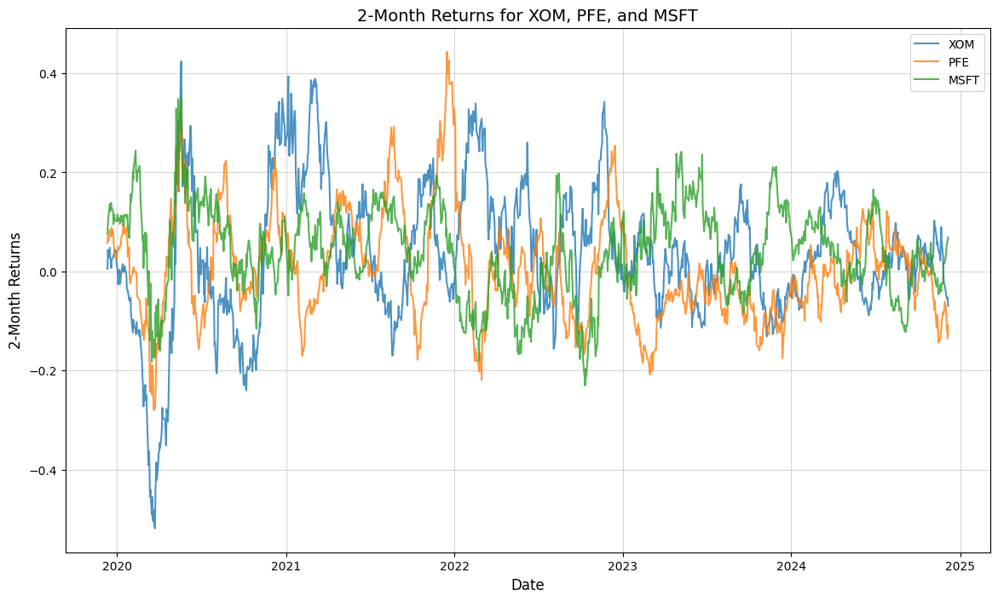
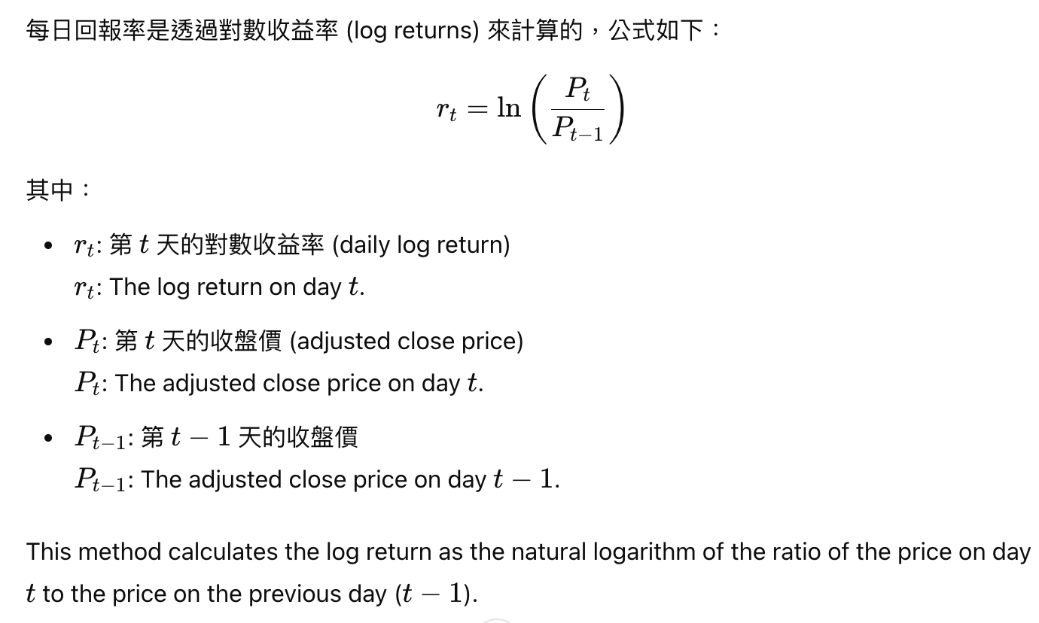
Xtreme Gradient Boosting (XGBooST)
Step 1 : Calculate daily return
Log returns are better for XGBoost because they stabilize the data, reduce outliers, and maintain additive properties, which align well with the model's ability to capture non-linear patterns in time-series analysis.
IDA Template

Slide 25
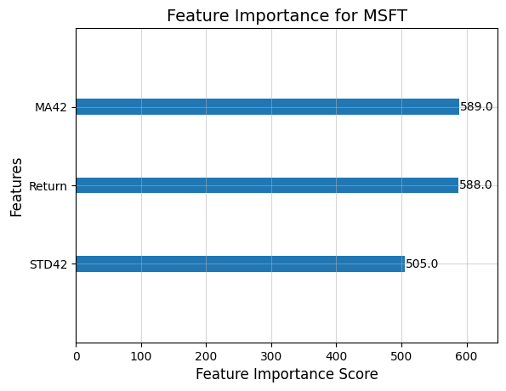
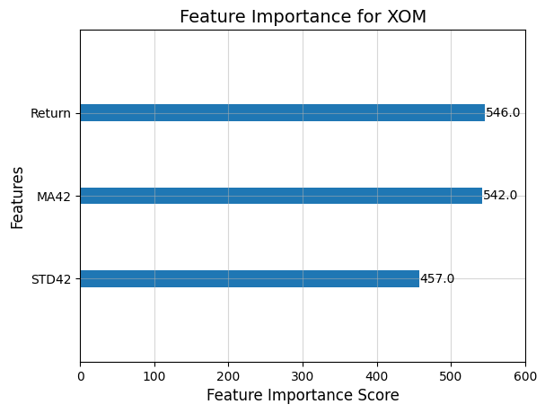
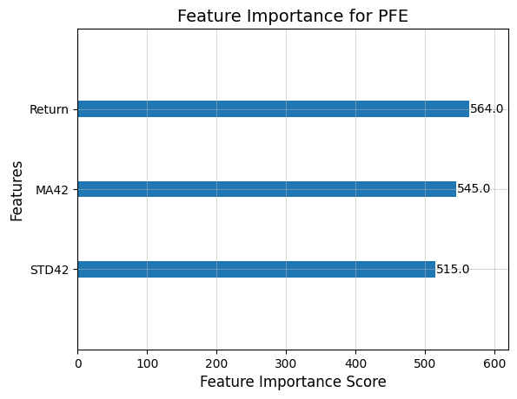
Xtreme Gradient Boosting (XGBooST)
Step 2 : Feature Engineering
The current feature importance distribution appears to be "reasonable" because:
The numerical range is close, without extreme imbalance.
It aligns with the business characteristics of different stocks (short-term return and mid-term trends are significant).
It is consistent with the classification objectives of the model.
IDA Template

Slide 26
Xtreme Gradient Boosting (XGBooST)
Step 2 : Feature Engineering
Feature | Purpose | Rationale | Benefit to Model
Return | Daily price changes | ln(Pt​/Pt−1​), stable, additive | Key movement info, aids fitting
MA42 | Captures trends | 42-day smooths noise, reveals market phases | Directional insights, trend prediction
STD42 | Measures volatility | 42-day shows stability, highlights risks | Context for extremes, improves accuracy
Combined | Trend + volatility | Comprehensive price behavior insights | Better generalization, robust forecasts
IDA Template

Slide 27
Xtreme Gradient Boosting (XGBooST)
Step 3 :
Separate training and testing dataset (70% training, 30% testing)
Step 4:
Portfolio Optimization
Calculate portfolio Sharpe Ratio based on test set returns.
Optimize weight allocation, balancing returns and risks.
股票代號 | Accuracy (%) | MSE
XOM | 46.85 | 0.2778
PFE | 51.78 | 0.2831
MSFT | 48.77 | 0.3299
The optimal portfolio's 5-year total return: 34.7288%
Conclusion: The optimal allocation indicates a 100% investment in MSFT, yielding a 5-year cumulative return of 34.7288%. This highlights MSFT's strong performance but emphasizes the need for diversification to mitigate potential risks.
IDA Template

Slide 28
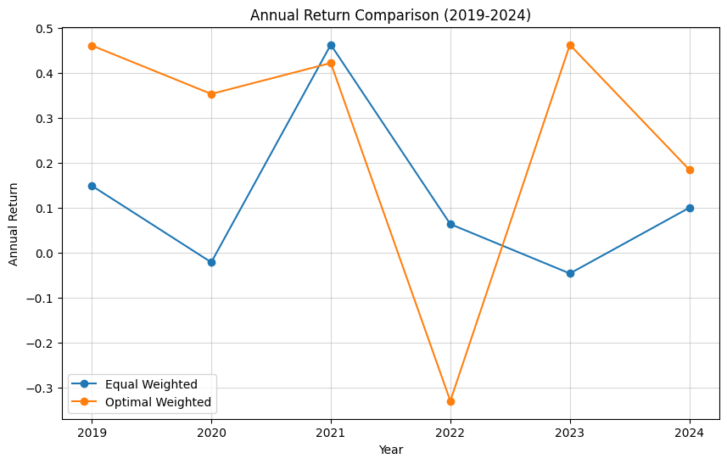
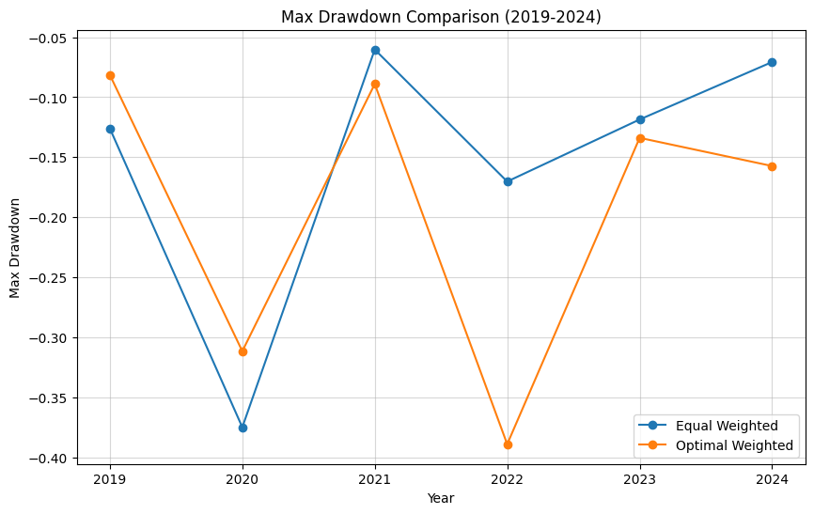
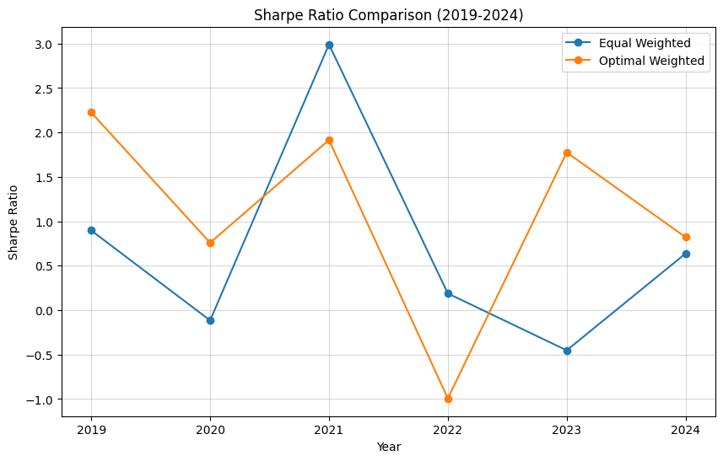
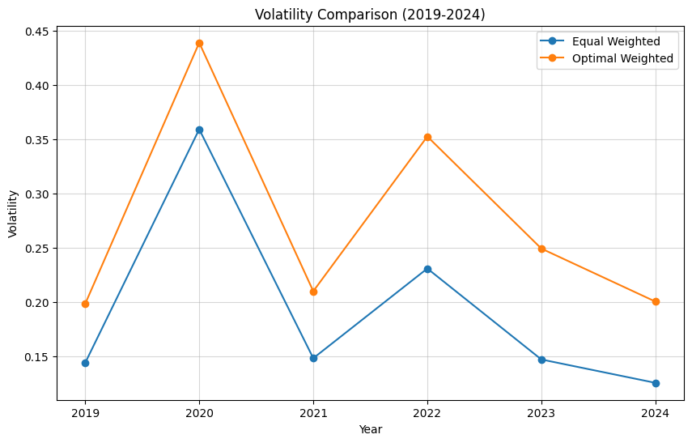
Xtreme Gradient Boosting (XGBooST)
Step 5 :
Benchmarking as list from XGB model with dynamic-weight strategy and Equal-weight Average Model
Conclusion and Suggestions
The equal-weighted portfolio suits risk-averse investors seeking stable returns.
The optimal-weighted portfolio excels in drawdown control and volatility reduction but carries higher risks.
For long-term growth, combine both strategies and adjust allocations based on market conditions.
IDA Template

